Slide 1
Ray Tracing
Peter Tsun and Brian Mueller

Slide 2
Part 1: Theory
Peter Tsun

Slide 3
Background: Ray Tracing
In 1968, Artur Appel came up with a way to render a scene on a screen by sending rays through each pixel on the screen to determine the color for the pixel.

Slide 4
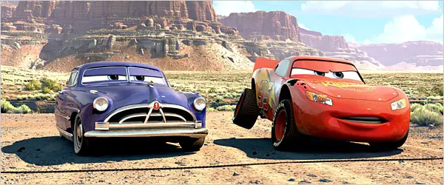
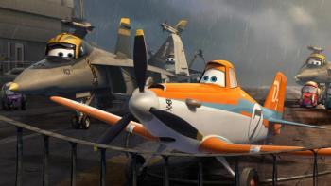
Cars 2006 Ray Tracing Planes 2013

Slide 5
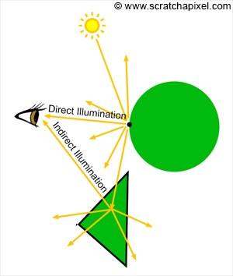
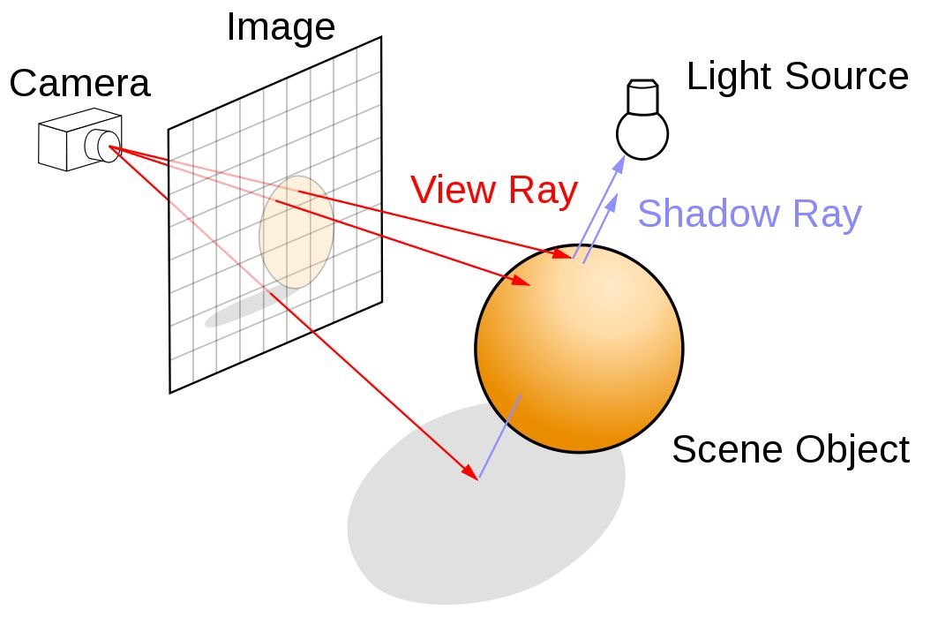
Light-based Ray Tracing in Nature Eye-based Ray Tracing in Image Rendering

Slide 6
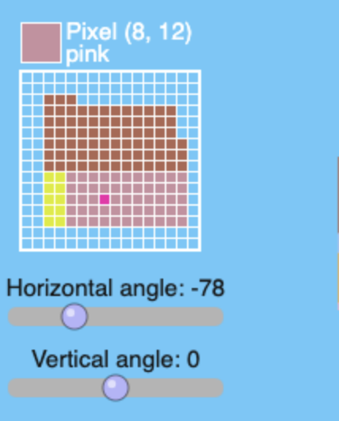
On Slack:
Activity
What pixel, horizontal angle, and vertical angle render a PINK pixel?
Pixel: #,#; H: #; V: #
Example:
Pixel: 10,12; H: 30; V: -82
Note: there is more than one right answer!

Slide 7
A 3-minute breakout session
In your group, discuss what you know about vectors and discriminant in a quadratic formula. Prepare to share your thoughts with the large group.

Slide 8
Ray-Sphere Intersection
RAY
R_{o} = [ X_{o} Y_{o} Z_{o} ] (Ray Origin)
R_{d} = [ X_{d} Y_{d} Z_{d} ] (Ray Direction)
X_{d}² + Y_{d}² + Z_{d}² = 1 (R_{d} normalized)
R_{d}
Parametric Form
R(t) = R_{o} + R_{d} t , where t > 0
R_{o}

Slide 9
An Implicit Form Describing a Sphere
S_{C} = [ X_{C} Y_{C} Z_{C} ] (Sphere’s Center)
S_{r} (Sphere’s Radius)
[ X_{S} Y_{S} Z_{S} ] (a point on surface of sphere)
(X_{S} - X_{C} )² + (Y_{S} - Y_{C} )² + (Z_{S} - Z_{C} )² = S_{r}²

Slide 10
R(t) = R_{o} + R_{d} t , where t > 0
[X(t) Y(t) Z(t)] = [ X_{o} Y_{o} Z_{o} ] + [ X_{d} Y_{d} Z_{d} ] t , or
X(t) = X_{o} + X_{d} t , Y(t) = Y_{o} + Y_{d} t , Z(t) = Z_{o} + Z_{d} t
X(t) = X_{S} and Y(t) = Y_{S} and Z(t) = Z_{S}
(X_{S} - X_{C} )² + (Y_{S} - Y_{C} )² + (Z_{S} - Z_{C} )² = S_{r}² → At² + Bt + C = 0,
A = X_{d}² + Y_{d}² +Z_{d}², C = (X_{o} - X_{c})² + (Y_{o} - Y_{c})² +(Z_{o} - Z_{c})² - S_{r}²
B = 2[(X_{o} - X_{c})X_{d} + (Y_{o} - Y_{c})Y_{d} + (Z_{o} - Z_{c})Z_{d} ]
Values of A, B, C are for finding t ( length of a ray )

Slide 11
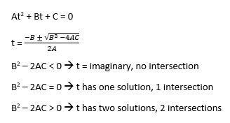

Slide 12
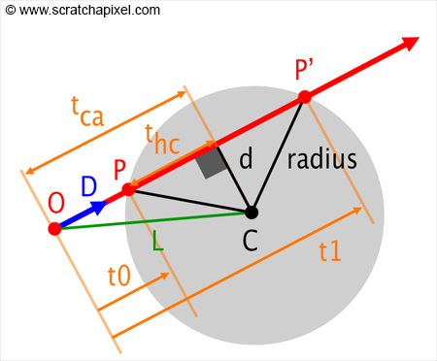
Geometric Approach
L = C - R_{O}
t_{ca} = L · R_{d} = L cos( θ )
(Dot Product of L & R_{d})
t_{ca} < 0 means no intersection
R_{d}
d² = L · L - t_{ca}² , r = radius
d > r means no intersection
R_{O}

Slide 13
Geometric Approach
L = C - R_{O}
t_{hc} = sqrt ( r² - d² )
t = t_{ca} - t_{hc} or t = t_{ca} + t_{hc}
Choose the smaller t
R_{d}
R_{O}

Slide 14
What is your take on mathematics?
Do you feel positive about math?
Do you have negative feeling towards mathematics?
Share your feeling on the slack poll with 1 being negative, 2 being neutral, and 3 being positive

Slide 15

Part 2: Coding
Brian Mueller

Slide 16
Ray Tracing + Code (for beginners)
C++
Java
Python
Javascript
etc.

Slide 17
C++
PROs
Fast
Good resources
Section 5 (quadratic formula)
CONs
Very difficult for beginners
We have no prior knowledge
Conclusion
👎

Slide 18
Java
PROs
Great for Minecraft
Ties to Kotlin (we'll see on the next slide)
CONs
Difficult to setup quickly
Conclusion
👎

Slide 19
Python
PROs
Good resources
One | [demo]
Animation with Kotlin
Two | [demo]
Easy to set up
Easy to modify
CONs
Still slow
Conclusion
👎

Slide 20
Javascript
PROs
Good resources
Easy to set up
Easy to modify
Simple stuff is fast
CONs
We didn't exclusively learn JS
Similar to Java
We've done P5js
Not great for advanced graphics
Conclusion
👍

Slide 21
Javascript Ray Tracer
Out of the box (example 3)
Documentation
README
src/Material.js, Render*, Scene.js → helper files
src/Vector3.js and Sphere.js → much of what Peter showed you
src/RayTracer.js#L124 → what color is this pixel?
You wouldn't often code your own ray tracer.
It's more important that you're able to use someone else's.
The limitation is often their documentation.
This one is pretty good, plus I added some HTML/JS to make it even easier to understand
Modified (examples/hunter)
Notes:
https://github.com/ercang/raytracer-js

Slide 22
Breakout Rooms
Fork the repl.
Preview hunter.html.
Modify the values in the boxes.
Open the code for hunter.js
Look through the code/comments.
Try commenting out scene.add(sphere1) then add your own shape(s).
Feel free to do the same with light(s).
Assist each other!
https://replit.com/@briansmueller/raytracer-js
NOTE: you will see comments for the homework. Do not start that yet.

Slide 23
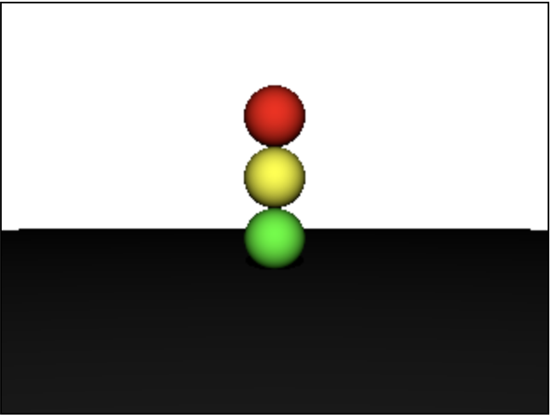
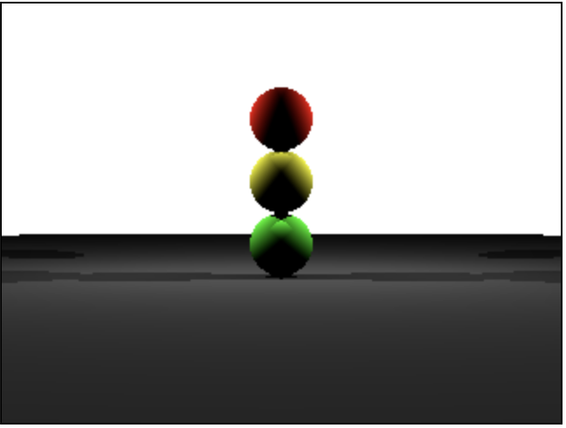
Homework
Task 1: Traffic Signal
Task 2: Two rear lights
Fork the repl, then follow the directions in the comments of hunter.js. Preview hunter.html.
EITHER put the link to your repl in the README of your work repo, OR include the files in your work repo

Slide 24
Async
Find an article about ray tracing and post your thoughts on async slack channel.

Slide 25
Thank you!

